Slide 1
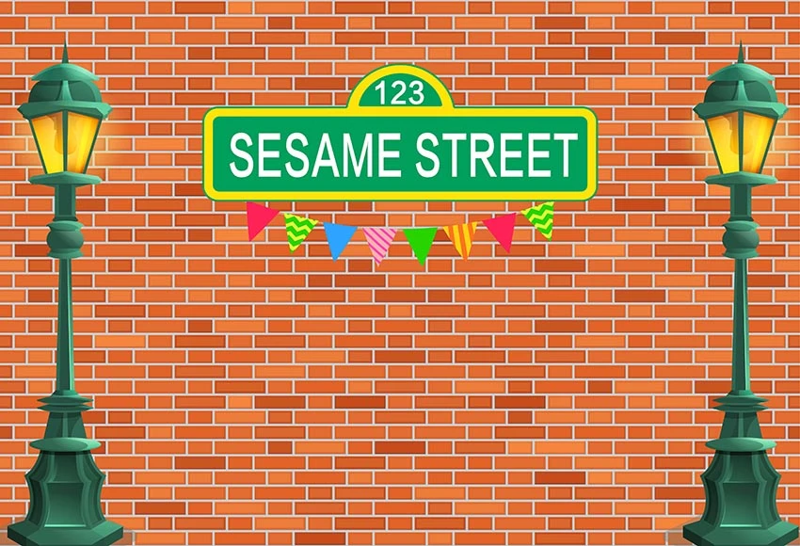
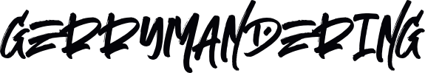

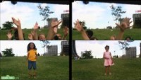

Block Party!
Saturday
Neighbors List
Charlie Dey
Marcus Golden
Andy Qui Le
VOTE
Nove
Your voice matters!
Faiz Ikramulla
Lena DS
Parker Broadnax
Ayomide Okuleye

Slide 2

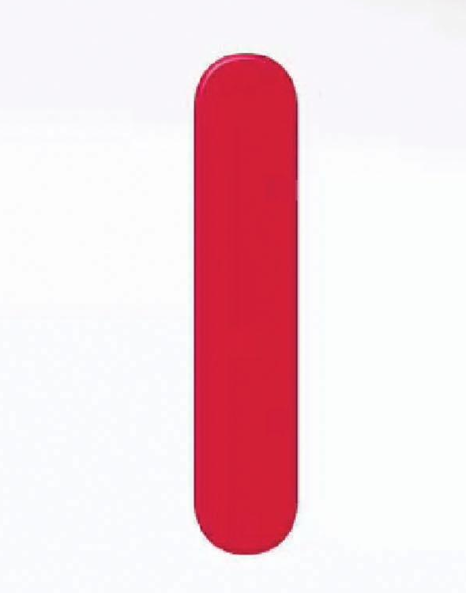
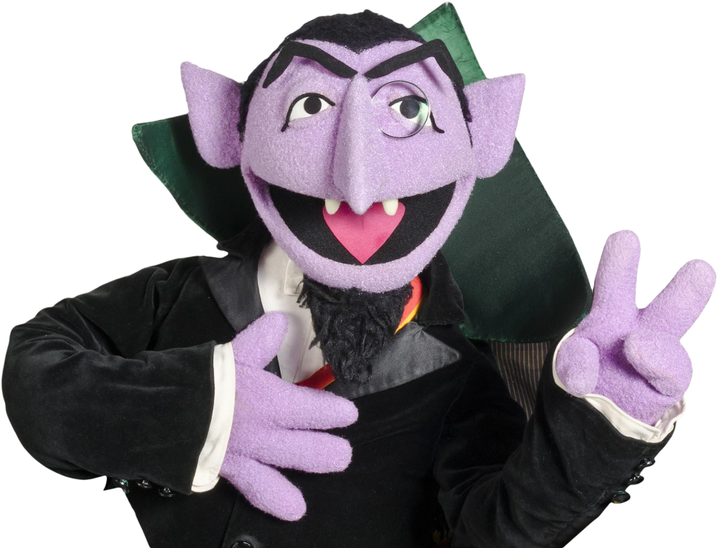
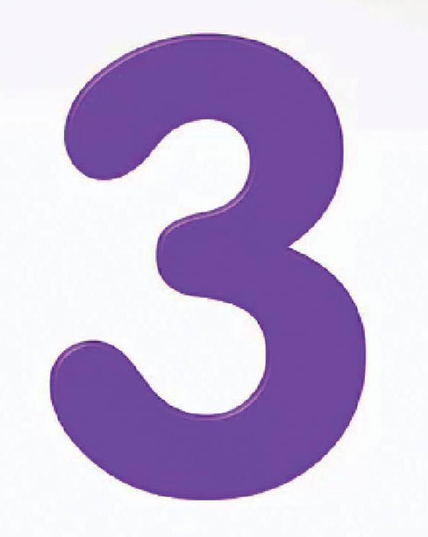
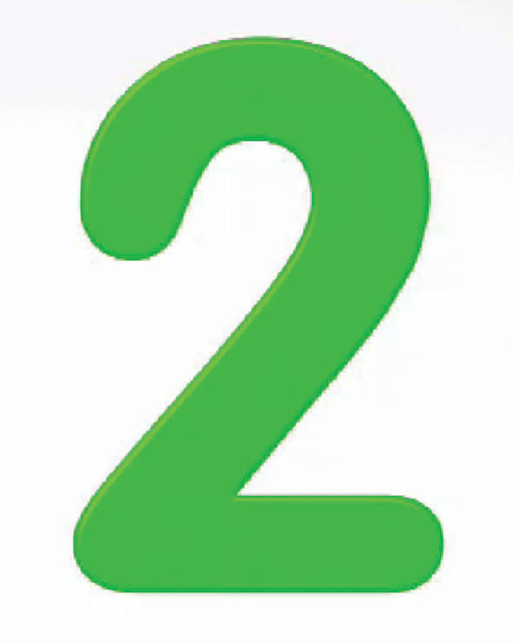

Sesame Street Neighbor’s Tasks
1 2 3
Goal: An evaluation tool to assess for fair voter districting
1. Starting prototype of the voter simulation
2. Acquire data sets to work with
3. Project plan mapped out

Slide 3
Sesame Street Neighbor’s Tasks
1 2 3
Goal: An evaluation tool to assess for fair voter districting
1. Finishing prototype of the voter simulation
2. Clean our data sets
3. Project plan revised mapped out (3rd time)

Slide 4
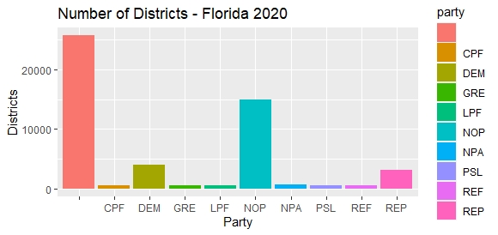
Sesame Street Neighbor’s Tasks
1 2 3
Visualization 2

Slide 5
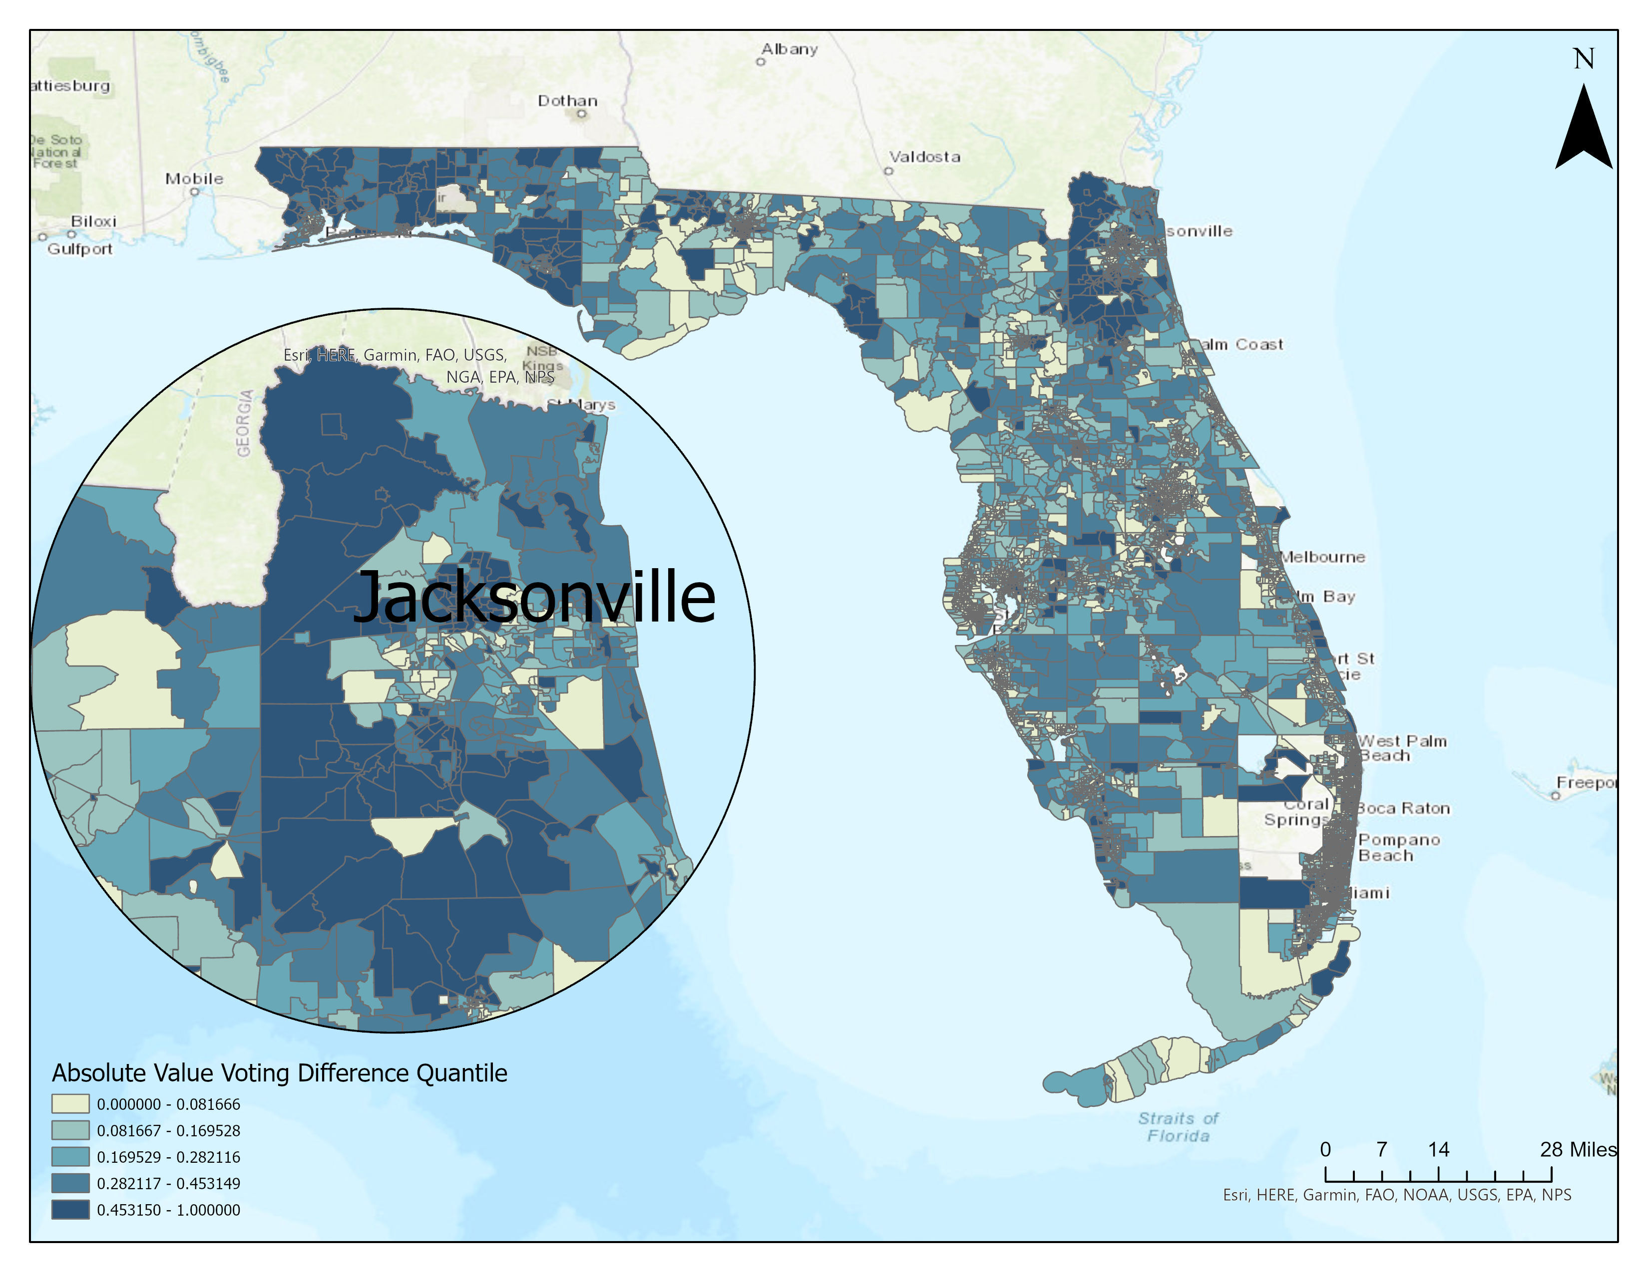
Sesame Street Neighbor’s Tasks
1 2 3
Visualization 1

